Slide 1
Linux C6x Syslink
Notes:
1
NEW

Slide 2
Agenda
What is Syslink?
Syslink Architecture
SharedRegion
What is Syslink-c6x?
Syslink-c6x Features
Syslink-c6x Dependency
Demo
References

Slide 3
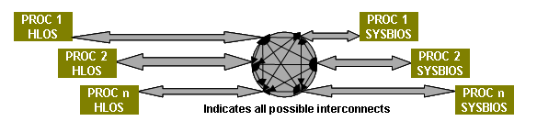
What is Syslink?
SysLink provides software connectivity between multiple processors present on the target platform. Each processor may run either an HLOS such as Linux, or an RTOS such as SYS/BIOS.
Core 1
HLOS
SharedRegion
Core 1
SYSBIOS
Core 2
HLOS
Core 2
SYSBIOS
Core N
HLOS
Core N
SYSBIOS

Slide 4
Syslink Architecture
HLOS IPC Applications
(eg. MessageQApp.c)
RTOS IPC Applications
(eg. MessageQApp.c)
HLOS Syslink APIs &
IPC Utilities
RTOS Syslink APIs &
IPC Utilities
HLOS IPC
RTOS IPC
Shared Region

Slide 5
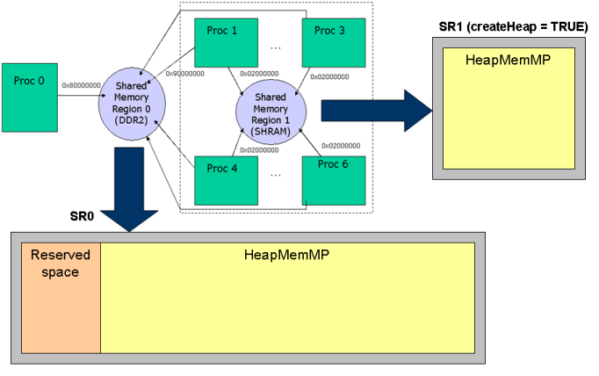
SharedRegion
SharedRegion module manages shared memory across processors
Core 1
BIOS
Core 3
BIOS
Core 0
Linux
Core 4
BIOS
Core 6
BIOS

Slide 6
What is Syslink-c6x?
Syslink-c6x is an extension of Syslink for c64x and c66x platforms
C6474
C6472
C6670
C6678

Slide 7
Syslink-c6x Features (1)
SysLink-c6x provides the following services to framworks and application:
Processor Manager
On a master processor to provide control functionality for a slave device
Allows host applicationi to attach an IPC instance to communicate with a remote core
In c6x, ProcMgr assumes that slave cores are loaded and run using other mechanisms, and does not support loading and starting of slave cores
Inter-Processor Communication protocols
Notify
MessageQ
GateMP
ListMP
HeapBufMP/HeapMemMP

Slide 8
Syslink-c6x Features (2)
Utility services
SharedRegion
List
MultiProc
NameServer
Not supported
ProcMgr
FrameQ
RingIO
HeapMultiBufMP

Slide 9
Syslink-c6x Dependency
TI CGT 7.2.2 https://www-a.ti.com/downloads/sds_support/TICodegenerationTools/download.htm
BIOS 6.32.01.38 http://www.ti.com/tool/sysbios
IPC 1.23.01.26 http://www.ti.com/tool/bioslinuxmcsdk
XDC tools 3.22.01.21 http://software-dl.ti.com/dsps/dsps_public_sw/sdo_sb/targetcontent/rtsc/3_22_01_21/

Slide 10
Demo
Build
Modify setenv
ROOTFS=“mcsdk-demo-root”
BUILD_SYSLINK=yes
Set dependency versions
(CGT_BIOS_VERSION, IPC_VERSION, XDC_VERSION, BIOS_VERSION)
Set dependency paths
(CGT_BIOS_DIR, CGT_LINUX_DIR, BIOS_DIR, XDC_DIR, IPC_DIR)
Image
product/evmc6678-initramfs-demo.el-hf-dev-<userid>-<date>.bin
Run
# cd /opt/syslink_evmc6678.el
# ./messageq_app_test_8_core.sh
or
# ./notify_app_test_8_core.sh

Slide 11
References
Linux-c6x 2.0 Release
Software Ecosystem: Syslink
http://linux-c6x.org/wiki/index.php/SysLink_for_c6x

